Slide 1

Piano Key Mapping
Christian Watts

Slide 2
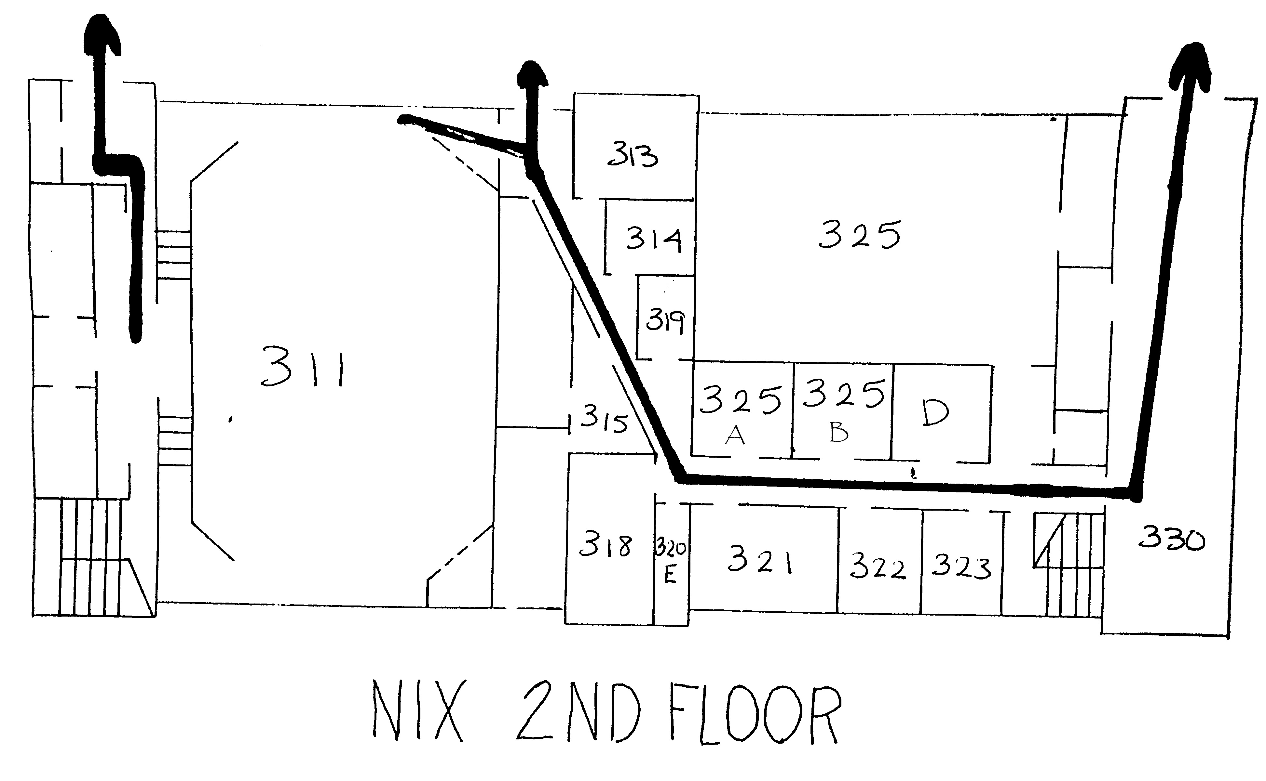
Pianos

Slide 3
A440 Standard
Sampled 3rd and 4th Octave, at 8000Hz

Slide 4
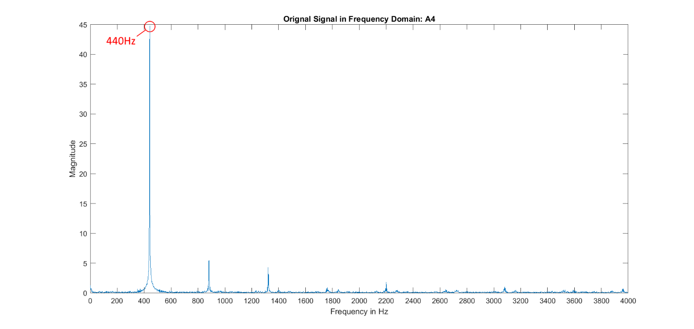
Typically, this is suppose to be the signal of a note in the frequency domain Just grab the highest magnitude

Slide 5
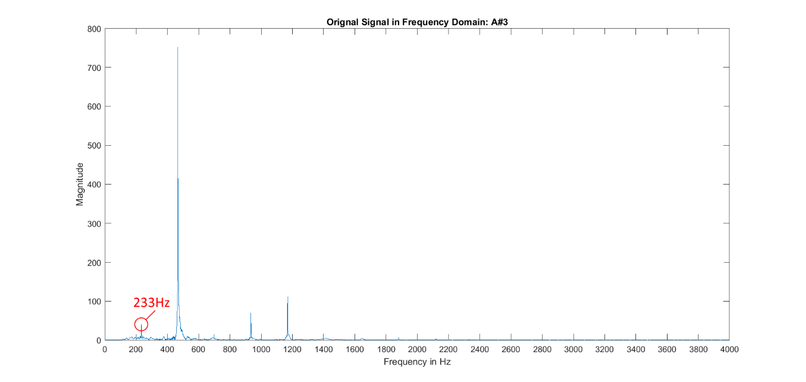
What happens when the highest magnitude isn’t the one you want? Here the harmonization with the octave above it was picked up as the highest Grab the first relatively large magnitude.

Slide 6
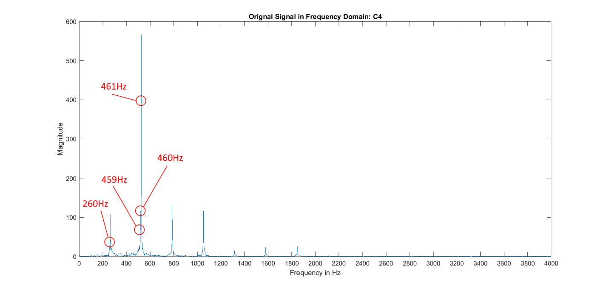
What about aliasing? Only 1s of signal is sampled so all these false positives may appear, throwing off picking up the first relatively high magnitude. Solving this problem in my current method was more work than I got out of it, so I redesigned it.

Slide 7
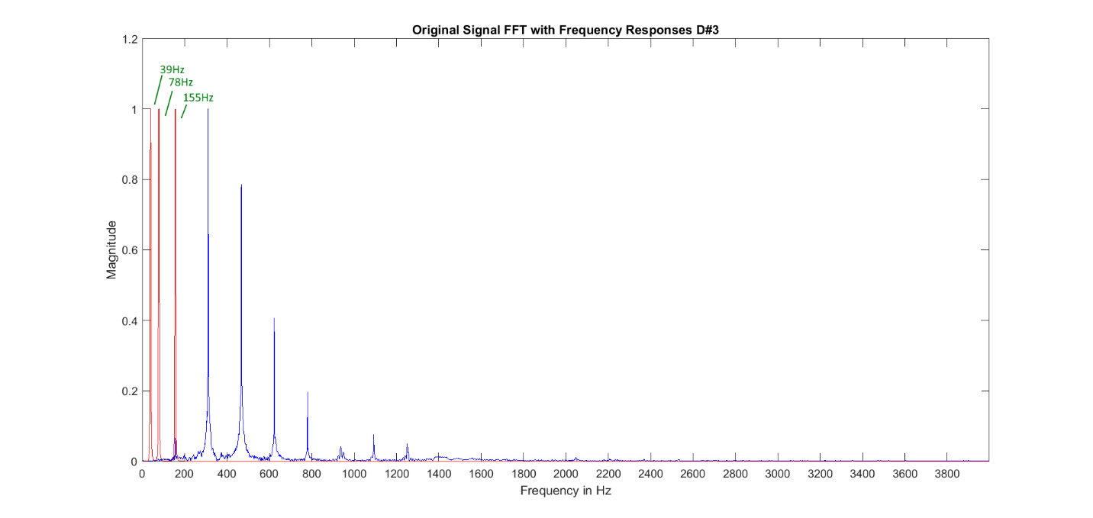
So to resolve this problem I redesigned my filter entirely, this time using an algorithm to generate multiple Bandpass Butterworth filters at fractions of the frequency 1/(2^0:8) and throw out those at below 27Hz

Slide 8
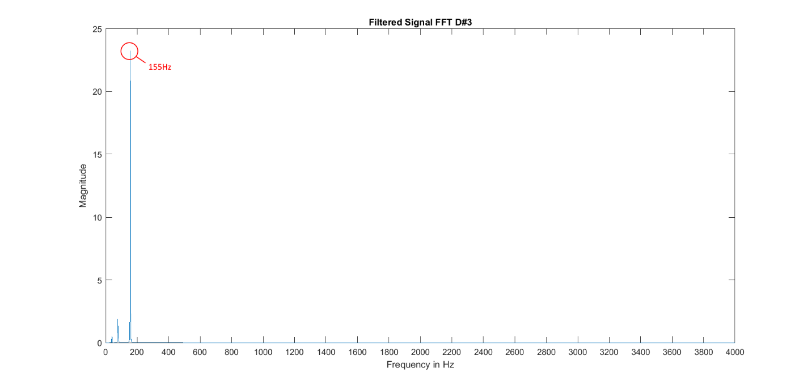
After filtering, FFT the signal and grab the highest magnitude

